Slide 1

Care Compare SK
Select, Compare, Share

Slide 2


OUR TEAM
Daris Lychuk
Kegan Lavoy

Slide 3


THE PROBLEM
OUR SOLUTION
People are wasting their valuable time manually searching for and comparing insurance providers due to the lack of a good centralized insurance comparator tool.
Care Compare SK is a web application that creates both a centralized place to compare multiple insurance companies’ prices, as well as an online community for people to share their own experiences.

Slide 4

Motivation and Inspiration
We have seen and heard enough people struggle with finding the right insurance plan for themselves. We are here to change that.

Slide 5



Modified MEVN Technology Stack
MySQL
Express.js
Vue.js
Node.js

Slide 6
OUR PROCESS
Early Stages
Development Stage
Redesign Stage
Testing Stage
Final Product

Slide 7

Early Stages and Planning

Slide 8
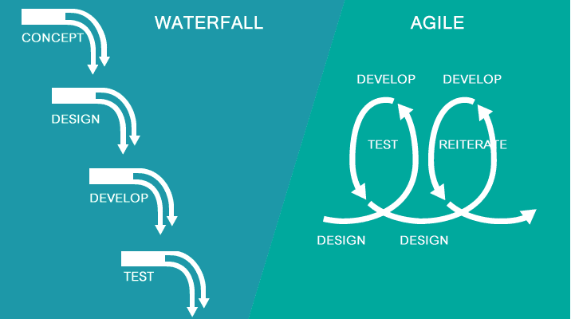
Engineering Design Process
Waterfall/Agile hybrid model

Slide 9
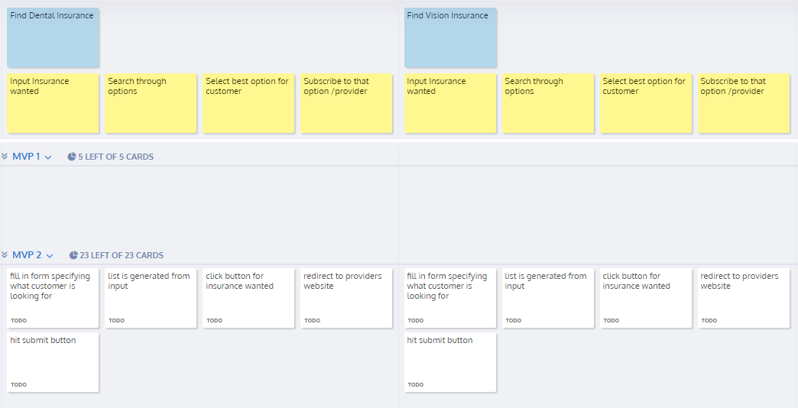
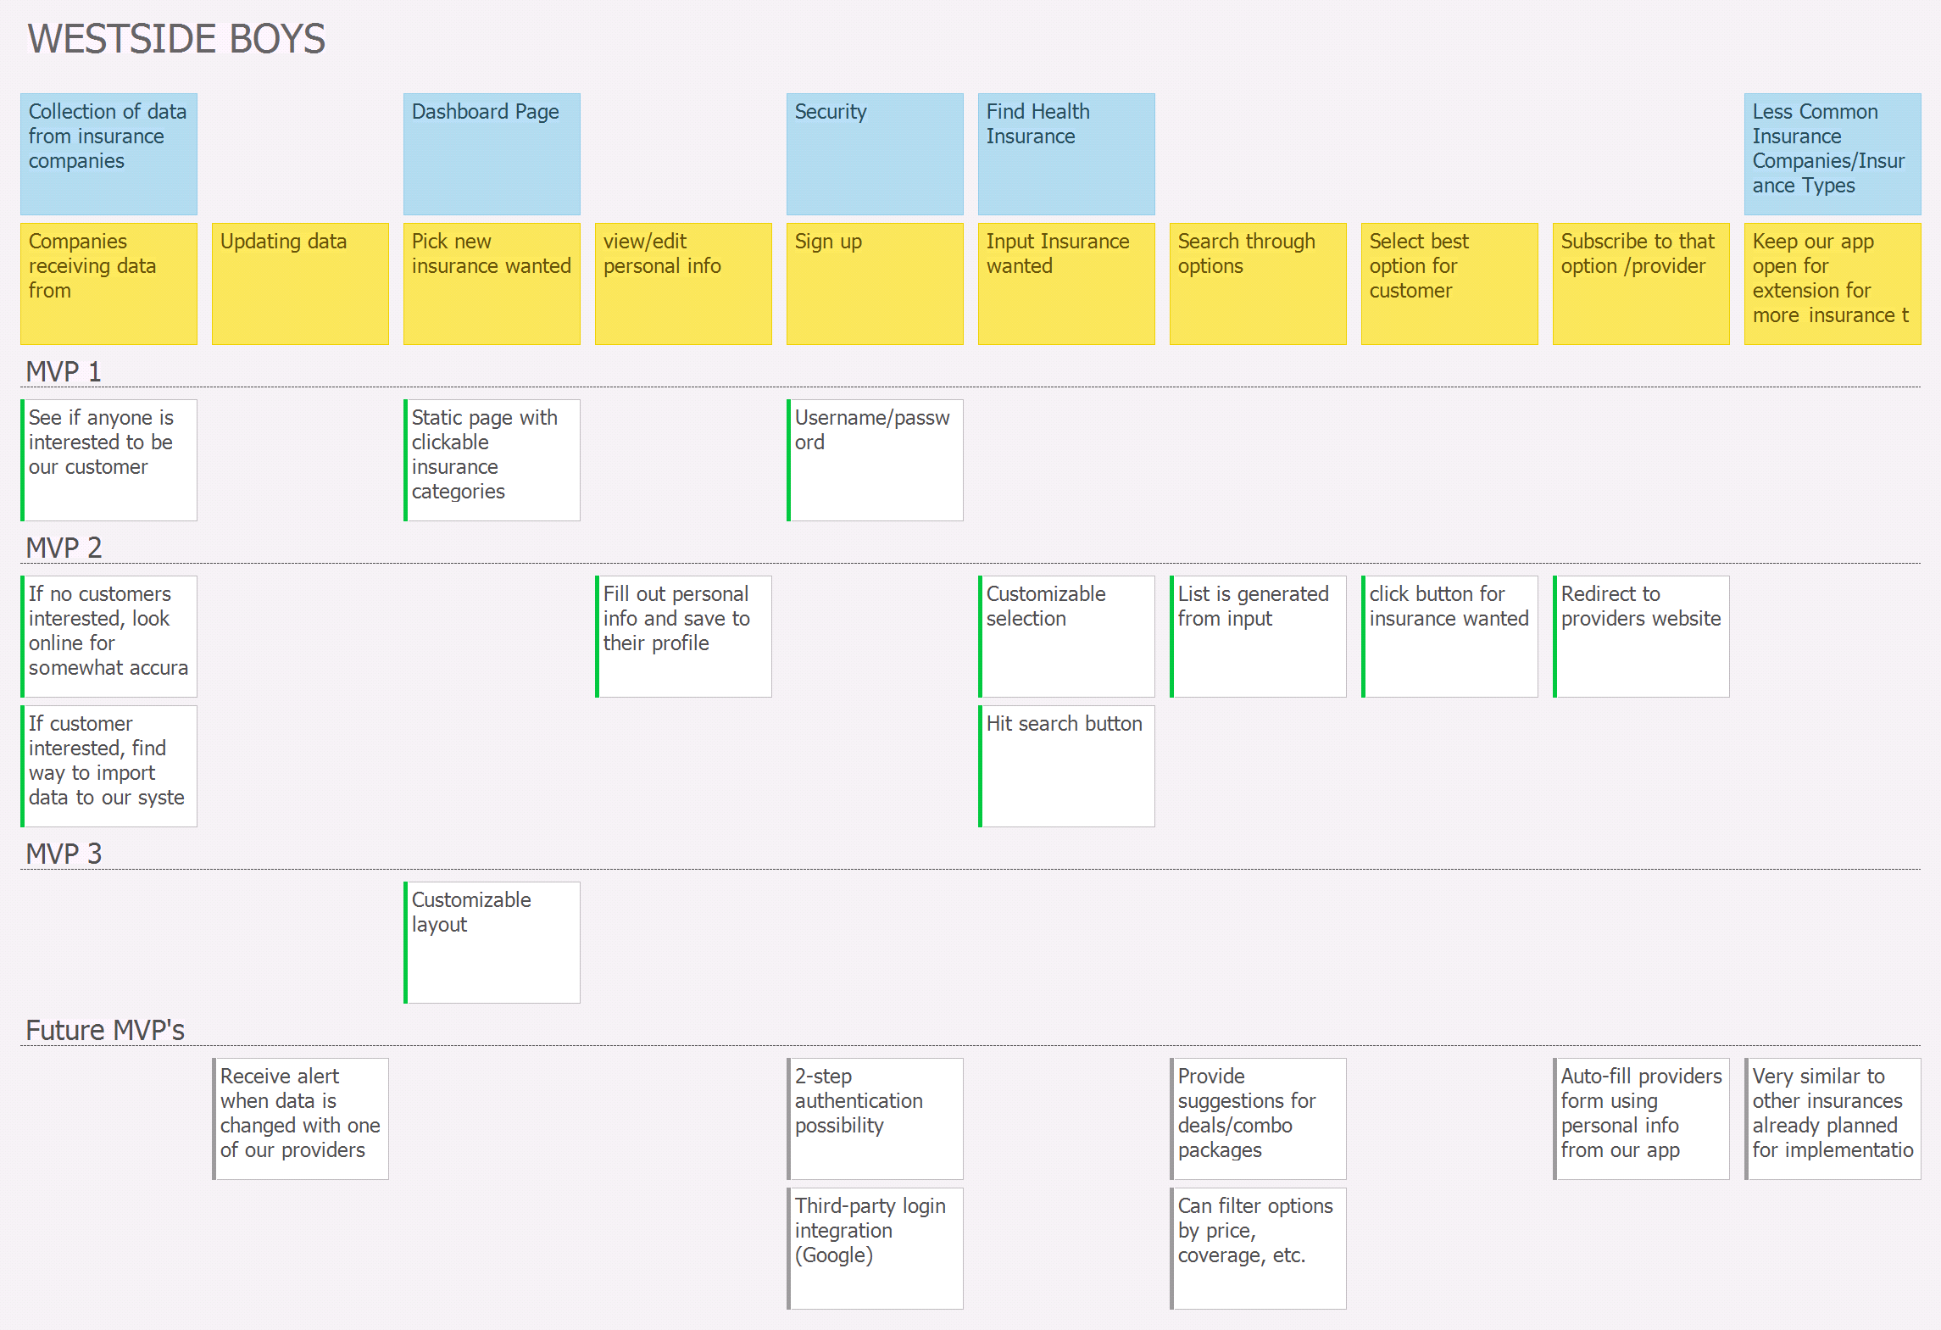
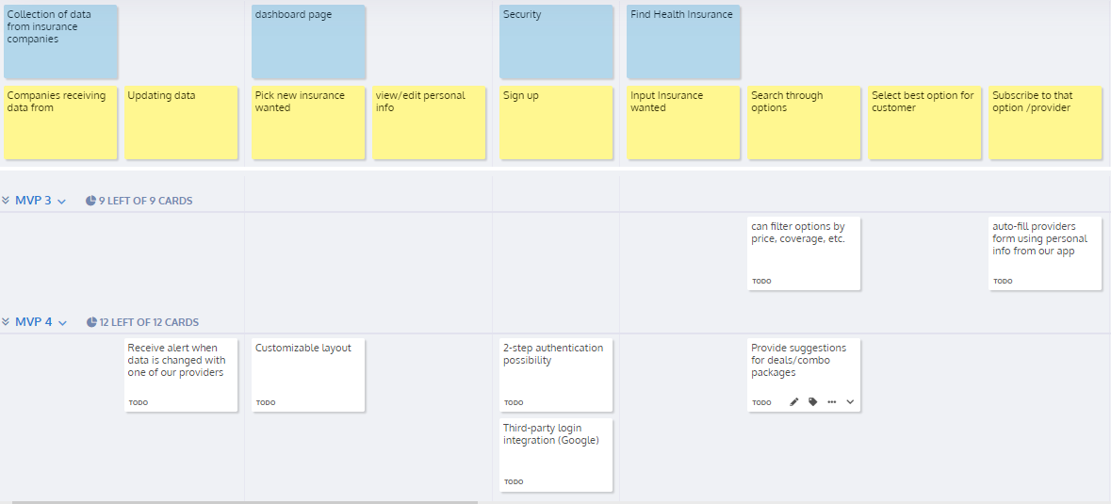
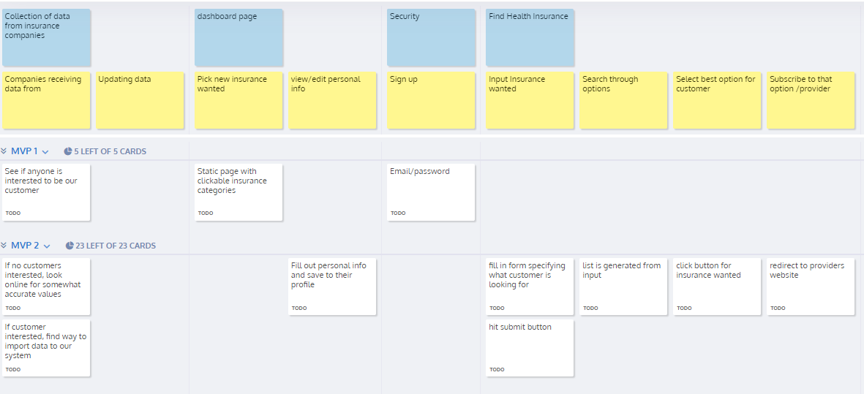
User Story Maps
Used as starting point for user/functional requirements

Slide 10



Personas
3 Personas

Slide 11
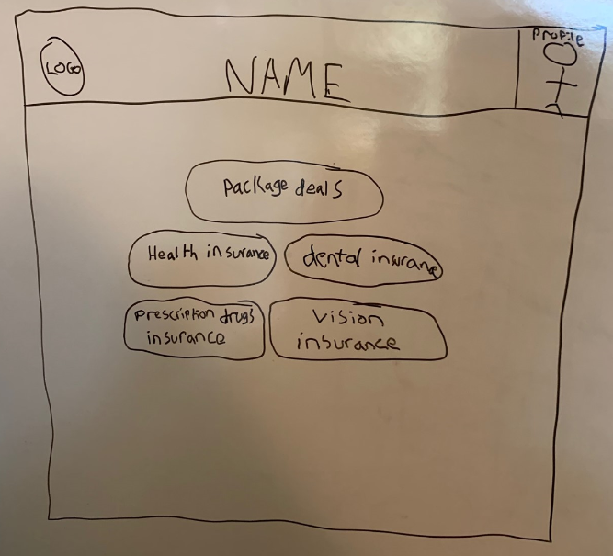
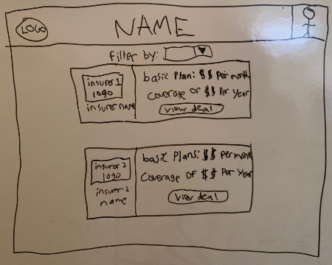
Lo-fidelity

Slide 12

Development Stage

Slide 13

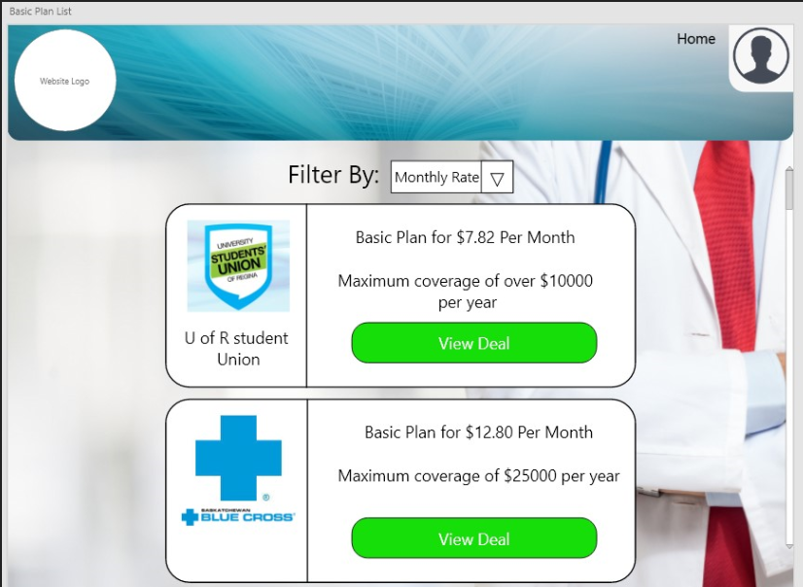
Hi-fidelity

Slide 14
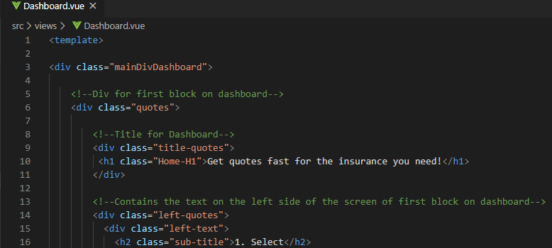
Coding

Slide 15

Redesign Stage

Slide 16


Insurer Focus
Community Focus

Slide 17
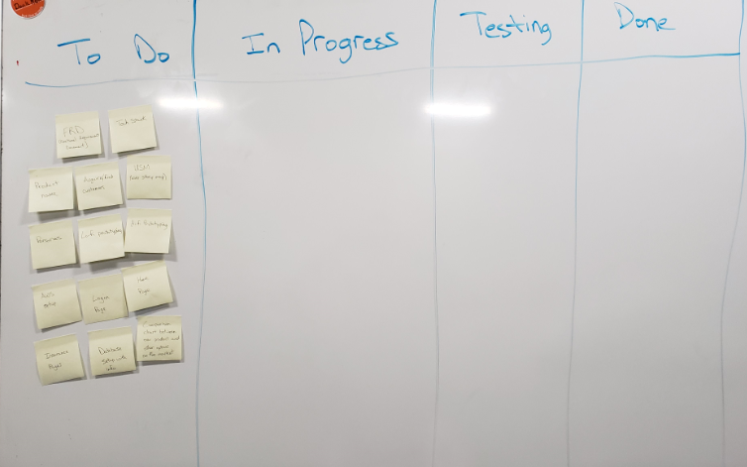
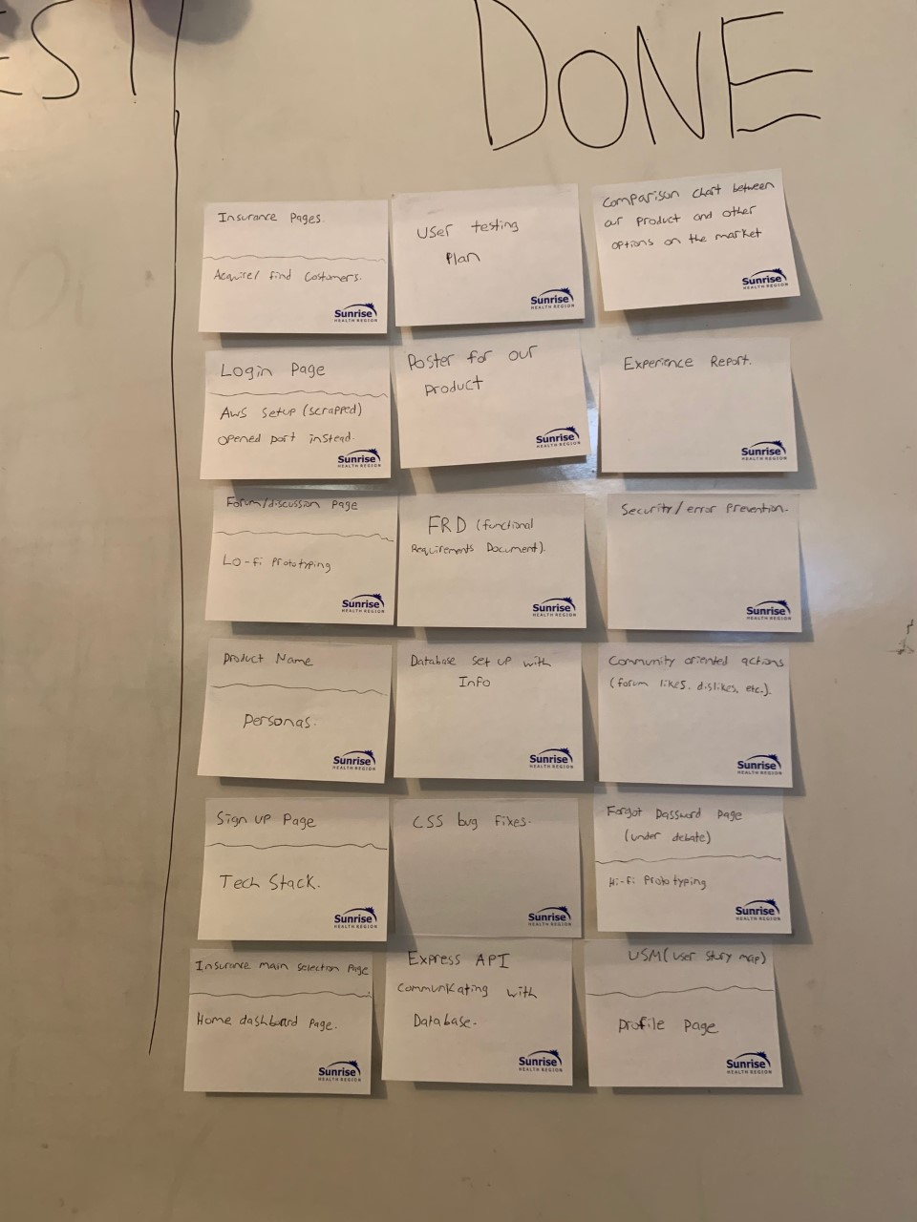
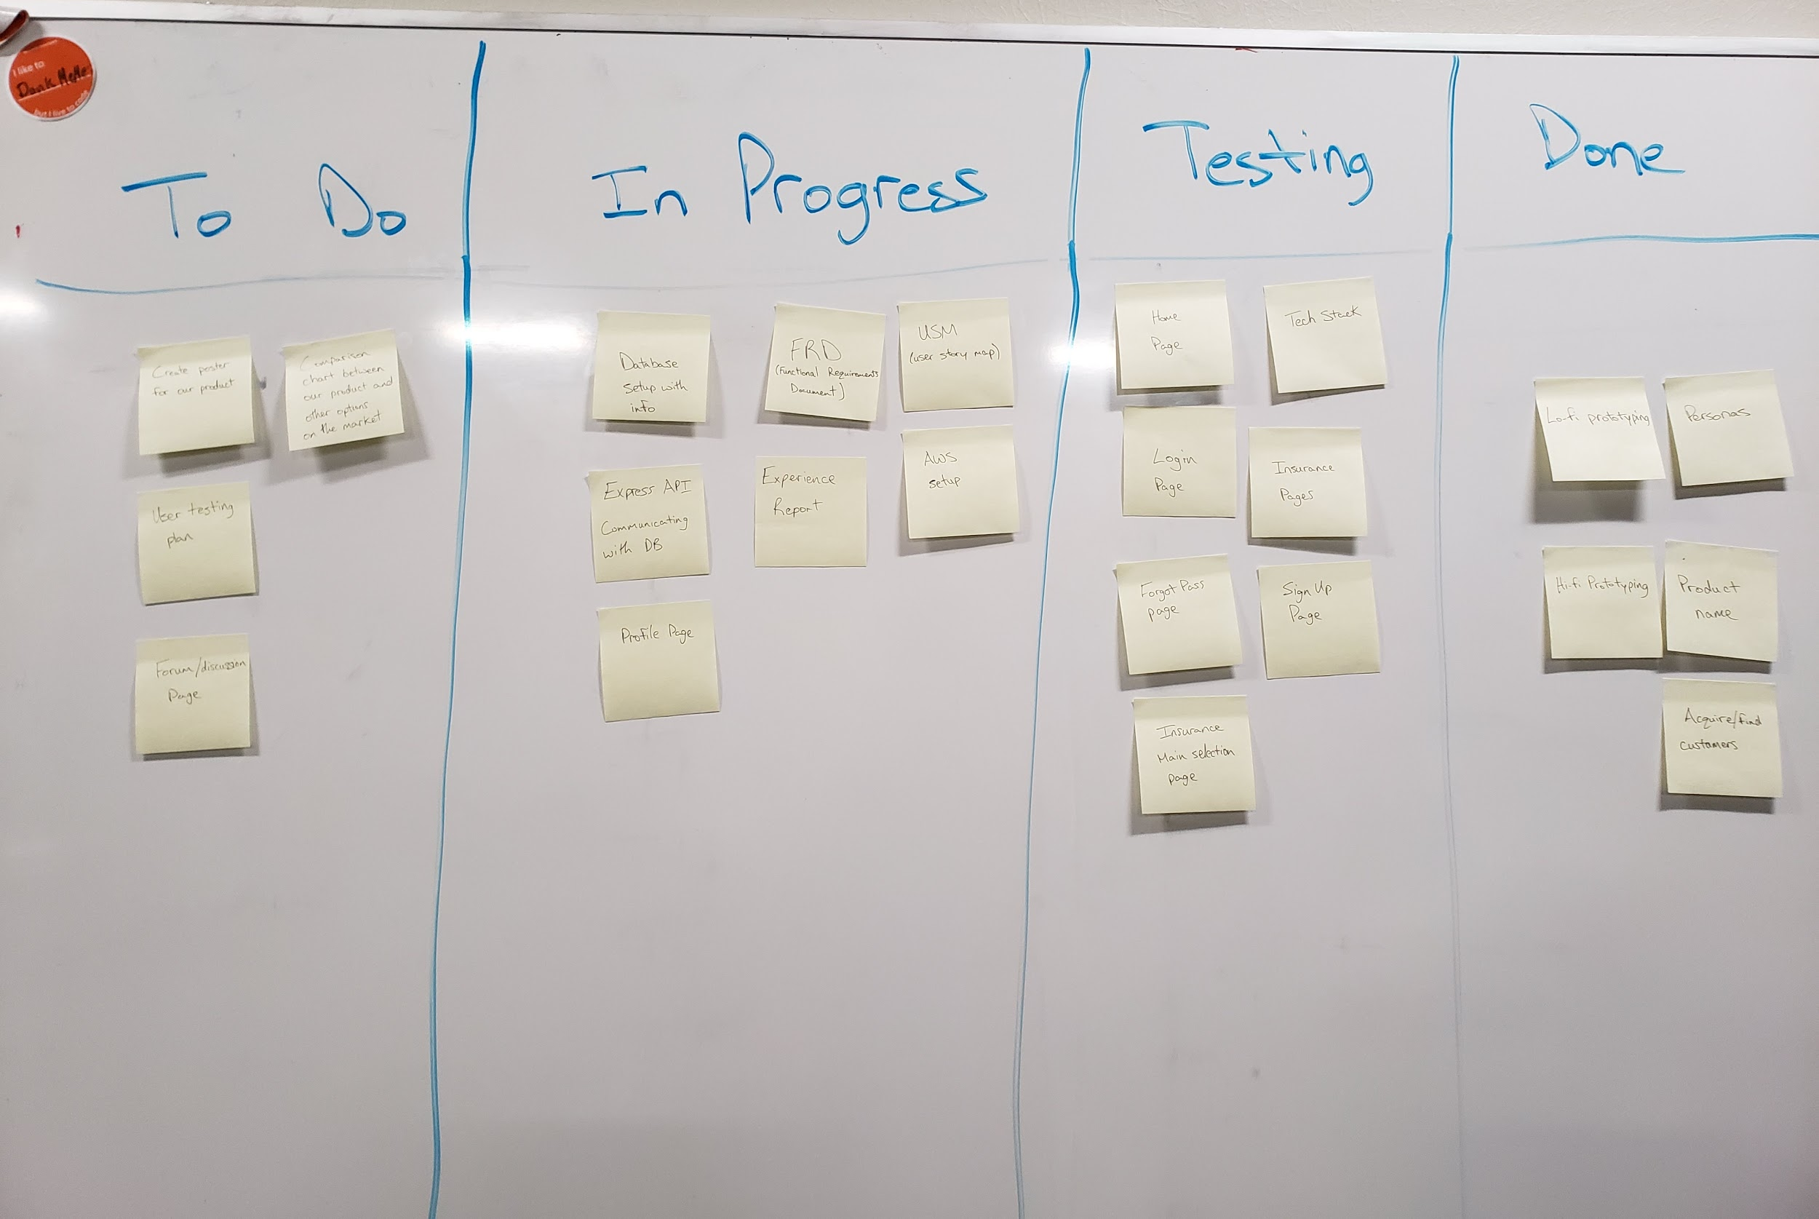
Kanban

Slide 18

Testing Stage

Slide 19

Testing
User Testing
Unit Testing
Screen Size Testing

Slide 20

Final Product Demonstration

Slide 21


COMPETITORS
Policygenius
LowestRates
Insurance Hotline
Policygenius is a well developed web application that allows users to compare insurance providers. Main downfall is that it is only for those residing in the United States
LowestRates is a Canadian web application that allows users to compare insurance rates. Main downfall is that it does not offer comparison of specific health insurance such as prescription drugs, dental, etc.
Insurance Hotline is a Canadian web application that allows users to compare insurance rates. Main downfall is that you must enter personal information to get an average estimate.

Slide 22
COMPETITION ANALYSIS
 | Free to use | Available with Canadian insurance companies | Allow for community interaction | Allow the community to provide quote values | Personal information is not needed
Care Compare SK
Policygenius
LowestRates
Insurance Hotline

Slide 23
Future Improvements
Insurance Companies
Forum Page
Sign-up/Sign-in Functionality
Monitor Sizes
API’s
Expand Care Compare SK
Get more insurance companies on board
Have forum page dynamically sort posts
Third-party sign-up and sign-in functionality
Care Compare SK to work on all devices
Auto-populate fields using public insurance company API’s
Care Compare SK to work across Canada

Slide 24


THANKS
https://github.com/keganlavoy/ENSE400
https://github.com/keganlavoy/CareCompareAPI
Notes:
https://www.google.com/url?sa=i&url=https%3A%2F%2Fcommons.wikimedia.org%2Fwiki%2FFile%3AOcticons-mark-github.svg&psig=AOvVaw2aYCgtrMpK3FDwQeHRgF3m&ust=1586453845842000&source=images&cd=vfe&ved=0CAIQjRxqFwoTCKics6Kv2egCFQAAAAAdAAAAABAI

Slide 25
CREDITS
Presentation template by Slidesgo
Icons by Flaticon
Infographics by Freepik
Images created by @onlyyouqj and Freepik - Freepik
Author introduction slide photo created by Freepik
Text & Image slide photo created by Freepik.com

